Slide 1
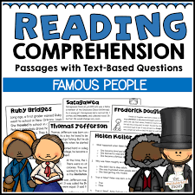
Reading Comprehension by MS. Farzana Khan

Slide 2
What is Reading Comprehension?
Reading comprehension means to comprehend (understand) the reading passage fully.
A comprehension exercise consists of a passage, upon which questions are set to test the student’s ability to understand the content of the given text and to infer information and meaning from it.
The purpose of exercise in comprehension is to ensure that the given passage has been thoroughly understood.
Usually students are asked to answer(based on their understanding) the set of questions given at the end.

Slide 3

Comprehension of text
Reading and properly comprehending a text is a complex and interactive process.
It requires several different brain functions to work together and most often requires one to puzzle through multiple layers of context and meaning.

Slide 4
Ways of Testing Comprehension
There are two ways of testing the comprehension.
Following the given passage, a set of questions has been given at the end of the passages.
A set of multiple choice of questions is given at the end of the passage in order to see if the student has really understood the passage in all its details.

Slide 5
Guidelines to Comprehend a Passage
Read the passage fast in order to form a general idea of its theme and its main ideas.
Next read the passage more slowly with two aims in mind:
To confirm if your first impression was correct
To underline the key ideas
Study the questions thoroughly. Turn to the relevant portions of the passage, read them again, and then rewrite them in your own words, neatly and precisely
Use complete sentences.
Do not bother yourself, whether, an information/fact is correct or not.

Slide 6
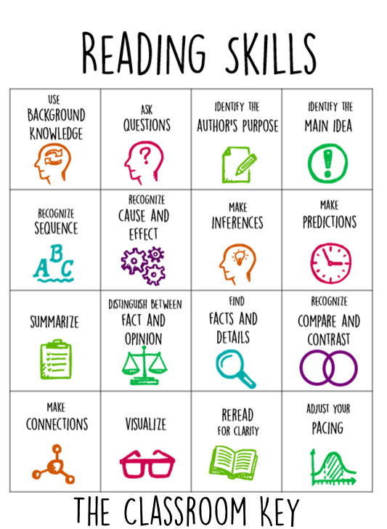
Strategies for Reading

Slide 7
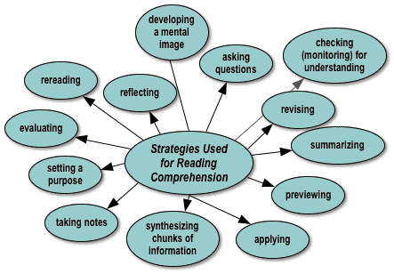
Strategies for Reading Comprehension: Expository Text

Slide 8
Main Idea/Summarization
A summary briefly captures the main idea of the text and the key details that support the main idea.
K-W-L
There are three steps in the K-W-L process (Ogle, 1986):
What I Know: Before students read the text, ask them as a group to identify what they already know about the topic. Students write this list in the “K” column of their K-W-L forms.
What I Want to Know: Ask students to write questions about what they want to learn from reading the text in the “W” column of their K-W-L forms. For example, students may wonder if some of the “facts” offered in the “K” column are true.
What I Learned: As they read the text, students should look for answers to the questions listed in the “W” column and write their answers in the “L” column along with anything else they learn.

Slide 9
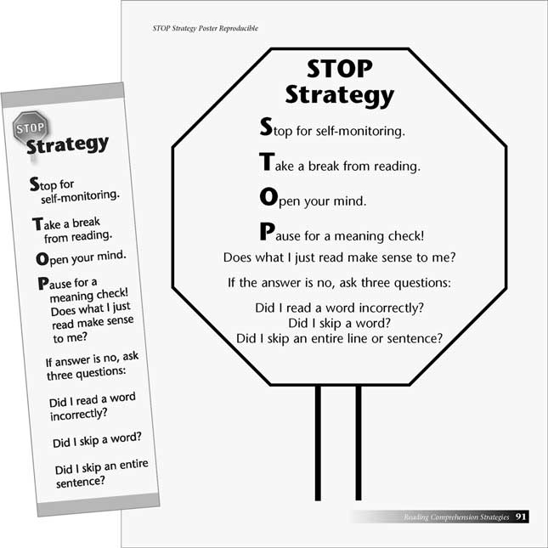
Step 1: Understand and Reevaluate How You’re Currently Reading
Step 2: Improve Your Vocabulary
Step 3: Read for Pleasure
Stop When You Get Confused and Try to Summarize What You Just Read
If You’re Struggling, Try Reading Aloud
Re-read (or Skim) Previous Sections of the Text
Skim or Read Upcoming Sections of the Text
Discuss the Text With a Friend (Even an Imaginary
Friend)

Slide 10
READING COMPREHENSION STRATEGIES FOR ANSWERING THE QUESTIONS
Skimming refers to reading a paragraph quickly to get an idea of what it is about, without trying to understand its details.
Scanning is what one does, for example, when looking for a phone number in a directory. You know the specific information you are looking for and you go down the page quickly to find it.
Extensive
Intensive
This technique is used when answering multiple-choice questions.

Slide 11
Tips for Answering the Questions
Read the question and turn to the relevant portions of the passage.
Read them again and rewrite them in your own words as far as possible.
Avoid reproducing parts of the given passage.
Write down the answers neatly and precisely.
All answers to questions on comprehension should be clear and concise.
Use simple language to express your ideas.

Slide 12
Tips for Answering the Questions
vii. Follow the rules of grammar and syntax properly.
viii. Try to understand the idioms, metaphors, similes and other figure of speech.
ix. Use complete sentences, and avoid bullets.
x. If you are asked to give the meaning of any words or phrases, you should express the idea as clearly as possible in your own words. Certainly words require the kind of definition that is given in a dictionary. Take care to frame the definition in conformity with the part of speech. Define in complete sentences.

Slide 13
Tips for MCQ’s
These are tricky questions that provide choices which are: -not stated in the passage; -stated, but are not relevant; -stated but could refer to a different topic; and opposite of the passage has stated.
Skim the passage
3. Skim the questions
4. Identify (underline) key words to target for scanning

Slide 14
Tips for MCQ’s
6. Scan for the target words
7. Once you locate the target words, read carefully around the target word to find your answer.
8. Be wary (cautious) of distracters.
9. Don't spend too much time on a particular item. Skip, but make it a point to go back to the item/s skipped if you still have time.
10. Cross-out the choices that you have identified as incorrect.

Slide 15
Specimen for Comprehension
Socrates had many disciples, and the greatest of these was Plato. Plato wrote many books which have come down to us, and it is from these books that we know a great deal of his master, Socrates. Evidently governments do not like people who are always trying to find out things; they do not like the search for truth. The Athenian Government - this was just after the time of Pericles – did not like the method of Socrates, and they held a trial and condemned him to death. They told him that if he promised to give up his discussion with people and changed his ways; they would let him off. But he refused to do so, and preferred the cup of poison, which brought death, to giving up what he considered his duty. When on the point of death, he addressed his accusers and judges and said:“If you propose to acquit me on condition that I abandon my search for truth, I will say: ‘ I thank you, O Athenians, but I will obey God, who, as I believe, set me this task, rather than you; and as long as I have breath and strength I will never cease from my occupation with philosophy. I will continue the practice of accosting whomever I meet and saving to him. ‘ are you not ashamed of setting your heart on wealth and honor while you have no care for wisdom and truth and making your soul better?’ I know not what death is – it may be good thing, and I am not afraid of it. But I do know what it is a bad thing to desert one’s post, and I prefer what may be good to what I know to be bad.”

Slide 16
Questions:
Why was Socrates condemned to death by his government?
On what condition was the government willing to let him go?
What was Socrates’ reaction to that offer?
What did Socrates consider his duty to the people?
Write down the meaning of the underlined words.

Slide 17
Answers of the Questions:
Socrates was condemned to death by his government which did not approve of Socrates’ method of making people search for truth and wisdom by questioning and discussing everything.
The government was willing to let Socrates go free if he promised to desist from holding discussion with people to help them find the truth, and if he changed his ways.
Socrates rejected that offer; and declared that he would rather obey God, who had placed him in this world to carry on his work as a philosopher, than bow before his accusers.
Socrates considered it is his duty to teach the people of Athens that the search for truth, wisdom and betterment of the soul was truly valuable while the shameful quest for wealth and power was not.
Disciple: A person who learns from another, an active follower or an adherent to someone’s philosophy. Trial: a test, an appearance at judicial court in order to be examined. Accusers: one who level charges against a man. Acquit: to declare or find innocent or not guilty. Abandon: to give up or to relinquish , to surrender, to desert

